Slide 1
An Introduction to 8086 Microprocessor.
From : K.R VenuGopal

Slide 2
Levels Of Programming
Machine Level Programming
Assembly Level Programming
High Level Programming

Slide 3
Microprocessors
Micro → Small size
Processor → device that performs computational & control operations
“ Microprocessor is a programmable electronic device that controls interpretation and execution of the instructions”. It is called CPU of the computer.
The current single chip, 16- bit microprocessor has major design and manufactures
The 8086 : designed by Intel.

Slide 4
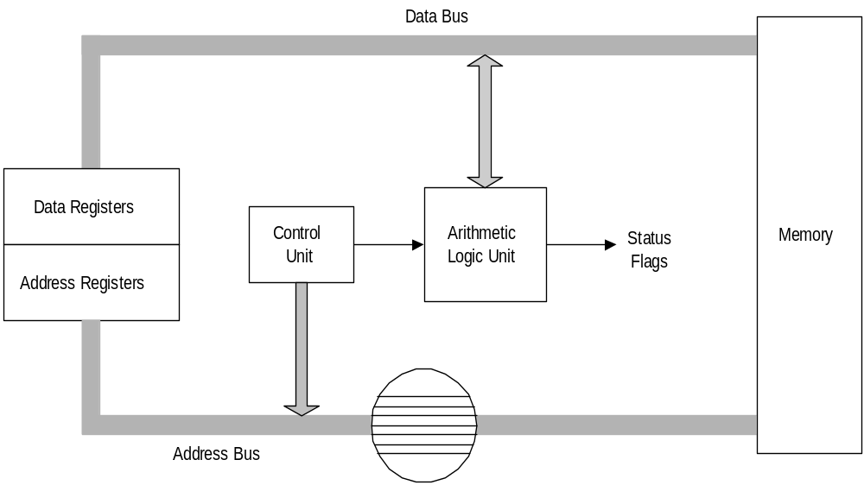
Simplified CPU Design

Slide 5
8086 Features
16-bit Arithmetic Logic Unit
• 16-bit data bus
• 20-bit address bus - 2²⁰ = 1,048,576 = 1 meg
The address refers to a byte in memory. In the 8086, bytes at even addresses come in on the low half of the data bus (bits 0-7) and bytes at odd addresses come in on the upper half of the data bus (bits 8-15).
The 8086 can read a 16-bit word at an even address in one operation and at an odd address in two operations.
The least significant byte of a word on an 8086 family
microprocessor is at the lower address.

Slide 6
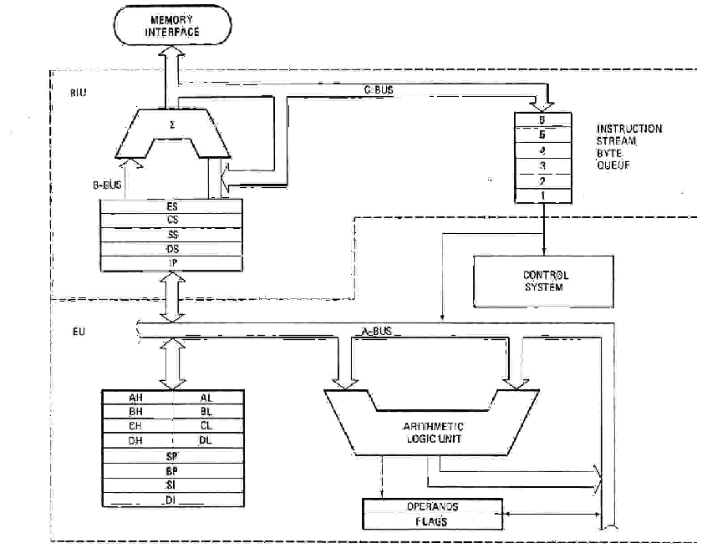
8086 Internal Block diagram

Slide 7
8086 Architecture
The 8086 has two parts, the Bus Interface Unit (BIU) and the Execution Unit (EU).
  1.) The BIU is responsible for transfer of
  instructions, address and data on the system
  bus to the execution unit. It handles the
  transfer of data between the processor,
  memory and i/o device.
  2.) The EU decodes and executes the instructions
  using the 16-bit ALU. Informs the BIU the
  location at which the next instruction or data
  is to be fetched.
  Phases of execution of the instruction:
  Fetch, Decode, Execute and Write.

Slide 8
BIU Registers
The BIU contains the following registers:
    CS - the Code Segment Register
    DS - the Data Segment Register
    SS - the Stack Segment Register
    ES - the Extra Segment Register
➔ CS, DS, SS & ES registers are used to store the 16-bit starting address of the four memory segments.
    IP - the Instruction Pointer
➔ IP holds the address of memory location (offset) the next instruction to be executed.

Slide 9
EU Registers
The EU contains the following 16-bit registers:
1.) General Purpose Registers
        AX - the Accumulator
        BX - the Base Register
        CX - the Count Register
        DX - the Data Register
2.) Pointer & Index Registers
        SP - the Stack Pointer
        BP - the Base Pointer
        SI - the Source Index Register
        DI - the Destination Register

Slide 10
3.) Status & Control Registers
        Flags
The AX, BX, CX, and DX registers can be considers as two 8-bit registers, a High byte and a Low byte.
        AX --> AH,AL
        BX --> BH,BL
        CX --> CH,CL
        DX --> DH,DL

Slide 11
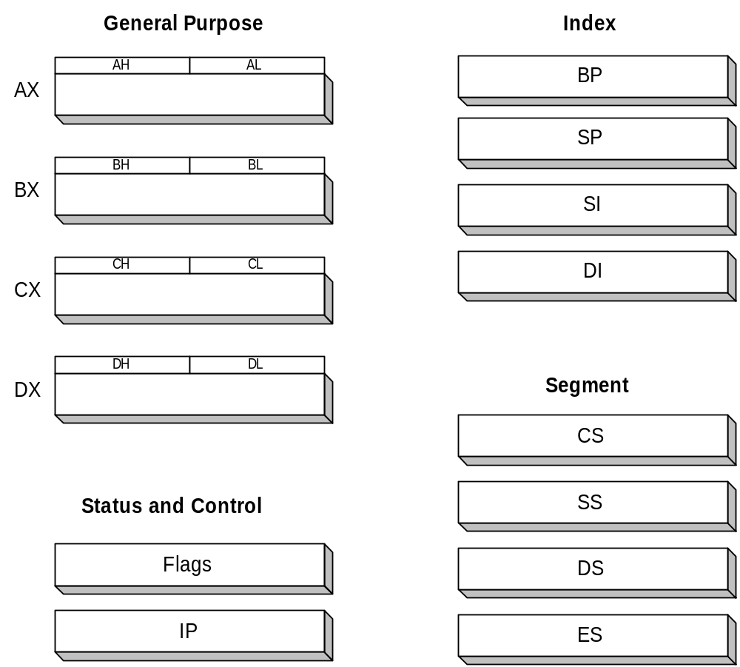
Intel 16-bit Registers

Slide 12
8086 Programmer’s Model
ES
Extra Segment
_{BIU registers}
_{(20 bit adder)}
CS
Code Segment
SS
Stack Segment
DS
Data Segment
IP
Instruction Pointer
_{EU registers}
AX
AH
AL
Accumulator
BX
BH
BL
Base Register
CX
CH
CL
Count Register
DX
DH
DL
Data Register
SP
Stack Pointer
BP
Base Pointer
SI
Source Index Register
DI
Destination Index Register
FLAGS

Slide 13
The 8086 Microprocessors: Registers
Registers
  Registers are in the CPU and are referred to by specific names
  Data registers
    Hold data for an operation to be performed
    There are 4 data registers (AX, BX, CX, DX)
  Address registers
    Hold the address of an instruction or data element
    Segment registers (CS, DS, ES, SS)
    Pointer registers (SP, BP, IP)
    Index registers (SI, DI)
  Status register
    Keeps the current status of the processor
    On an IBM PC the status register is called the FLAGS register
  In total there are fourteen 16-bit registers in an 8086/8088

Slide 14
Data Registers: AX, BX, CX, DX
Instructions execute faster if the data is in a register
AX, BX, CX, DX are the data registers
Low and High bytes of the data registers can be accessed separately
  AH, BH, CH, DH are the high bytes
  AL, BL, CL, and DL are the low bytes
Data Registers are general purpose registers but they also perform special functions
AX
  Accumulator Register
  Preferred register to use in arithmetic, logic and data transfer instructions because it generates the shortest Machine Language Code
  Must be used in multiplication and division operations
  Must also be used in I/O operations

Slide 15
BX
  Base Register
  Also serves as an address register
  Used in array operations
  Used in Table Lookup operations (XLAT)
CX
  Count register
  Used as a loop counter
  Used in shift and rotate operations
DX
  Data register
  Used in multiplication and division
  Also used in I/O operations

Slide 16
Pointer and Index Registers
Contain the offset addresses of memory locations
Can also be used in arithmetic and other operations
SP: Stack pointer
  Used with SS to access the stack segment
BP: Base Pointer
  Primarily used to access data on the stack
  Can be used to access data in other segments
SI: Source Index register
  is required for some string operations
  When string operations are performed, the SI register points to memory locations in the data segment which is addressed by the DS register. Thus, SI is associated with the DS in string operations.

Slide 17
DI: Destination Index register
  is also required for some string operations.
  When string operations are performed, the DI register points to memory locations in the data segment which is addressed by the ES register. Thus, DI is associated with the ES in string operations.
The SI and the DI registers may also be used to access data stored in arrays

Slide 18
Segment Registers - CS, DS, SS and ES
Are Address registers
Store the memory addresses of instructions and data
CS
- Contains Instructions of a program
DS
- Contains Program Data
ES
- Used for storing additional data and is used to hold and manipulate the string data.
SS
- Used for dedicated purpose of storing the program’s run-time stack.

Slide 19
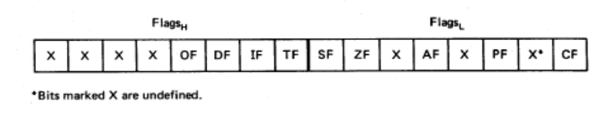
Flags
Carry flag
Overflow
Direction
Parity flag
Interrupt enable
Auxiliary flag
Trap
Zero
Sign
5 are status flags
4 are control flag

Slide 20
Flag Register
CF (carry) Contains carry from leftmost bit following arithmetic, also contains last bit from a shift or rotate operation.
OF (overflow) Indicates overflow of the leftmost bit during arithmetic.
DF (direction) Indicates left or right for moving or comparing string data.
IF (interrupt) Indicates whether external interrupts are being processed or ignored.

Slide 21
TF (trap) Permits operation of the processor in single step mode.
SF (sign) Contains the resulting sign of an arithmetic operation (1=negative)
ZF (zero) Indicates when the result of arithmetic or a comparison is zero. (1=yes)
AF (auxiliary carry) Contains carry out of bit 3 into bit 4 for specialized arithmetic.
PF (parity) Indicates the number of 1 bits that result from an operation.

Slide 22
Instruction Set of 8086
Processor 8086 supports wide arrays of instructions to perform:
Data Transfer Instructions
Arithmetic Logic Instructions
Branch Instructions
Processor Control Instructions
String Operation Instructions
Protection Control Instructions

Slide 23
Instruction Types
Zero Operand Instructions
One Operand Instructions
Two Operand Instructions
Three Operand Instructions

Slide 24
Addressing Modes
Immediate Addressing Modes
Implicit Addressing Modes
Direct Addressing Modes
Indirect Addressing Modes
Register Addressing Modes
Register Indirect Addressing Modes
Based Indexed Addressing Modes
Register Relative Addressing Modes
Relative Based Indexed Addressing Modes

Slide 25
Assembler Directives

Slide 26
Assembly language programs are composed of two types of statements:
1.) Instructions, which are translated to
machine code by the assembler.
2.) Directives, which gives directions to the
assembler and no machine code is
generated.
➔ Assembler supports directives for data
definition, segment organization,
macro definition etc

Slide 27
Variables & Constants:
Variables are symbols whose values can be dynamically varied during runtime.
The assembler assign a memory location to variable which is not visible to user & translates assembly language statements into machine language statements
It consist of:
A-Z, a-z, 0-9, _, @, $, ?

Slide 28
Rules of defining variable
-- must start with letter (alphabet) or _
-- maximum length is 32
-- no distinction b/w upper & lower case
Numeric Constants
Represented as:
1.) Binary Integers : Binary numbers end
with B, only contains 0 & 1’s
Example: 0100B

Slide 29
2.) Decimal Integer :Decimal constant
ends with D or nothing
Example: 0100D and 0100
3.) Hexadecimal Integers :
Hexadecimal constant ends with H
--if first symbol is b/w A to F,integer
must start with 0 for e.g. 0A
Example: 0F1H, 1010H, 923AH

Slide 30
Data Definition & Storage Allocation Directives
Used to define program variable & allocate specific amount of memory to them.
Types :
BYTE - 1 byte
WORD - 2 byte
DWORD - 4 byte
QWORD - 8 byte
TBYTE - 10 byte

Slide 31
1.) DB(Define byte type variable)
Used to define single or multiple type variables
Range: 0 to 255(unsigned numbers)
-128 to 127(signed)
Example 1: Total db 0
➔Reserve 1 byte of memory to total & initialize
with 0
Example 2: Table db 83,100,200,55
Example 3: List db ?,?,?,?,?
Example 4: Acode db ‘A’ or Acode db “A”
Example 5: Msg db ‘hello world$’

Slide 32
2.) DW(Define word)
Used to define 2 bytes variable.
Range: 0 to 65535(unsigned)
-32768 to +32767(signed)
Example 1: Total dw 0
Example 2: Total dw “84”
➔ First byte initialized with ASCII value of 4 &
Second byte with ASCII value of 8. Therefore,
word contains 3834H.
Example 3: Num dw “1”
➔ value 0031H

Slide 33
3.) DD (Double Word)
Define 4 bytes of variable.
Range: 0 to 2³²-1(unsigned)
-2³²⁻¹ to +2³²⁻¹-1(signed)
Example 1: Total dd ?
Example 2: Tot dd “1”
➔Value 00 00 00 31h

Slide 34
4.) DQ (Define Quadword)
Define 8 bytes of variable
Range: 0 to 2⁶⁴-1(unsigned)
-2⁶⁴⁻¹ to +2⁶⁴⁻¹ -1(signed)
5.) DT (Define Ten bytes)
Define 10 bytes of variable
Range 0 to 2⁸⁰-1(unsigned)
-2⁸⁰-1 to +2⁸⁰-1(signed)

Slide 35
Program Organization Directives
1.) SEGMENT
Used to indicate beginning of logical statement.
2.) ENDS
Informs the assembler the end of segment
General form:
SegmentName SEGMENT
---------------
Segmentname ENDS

Slide 36
Note: SegmentName is userdefined name.
Example: Data segment
------data definition here----
Data ends
Example: Mycode segment
-----------program code here---
Mycode ends
2.) ASSUME
Informs assembler the name of logical segment that should be used for specified segment.
When program is loaded ,the processor segment registers should point to respective logical segments.

Slide 37
General Form:
Assume SegReg: SegName,------------,
-----------,SegReg: SegName
where
Assume: is an assembler directive
SegName: userdefined segment
SegReg: any of register(CS,DS,SS,ES)
Four segment Registers:
Code segment register
Data segment register
Stack segment register
Extra segment register

Slide 38
Programs End directive
Program Termination Directive informs assembler about the physical end of program module.
The last statement of every program must be an END.
General form:
END : specify end of program
END Label : indicate execution begin from label.
Example : Main: ------program execution begins-----
--------------------------
END Main

Slide 39
Value-returning attribute Directives
1.) OFFSET
This directive informs assembler to determine displacement of specified variable with respect to base of segment.
Basically used to load offset of variable into register.
General form:
Offset Variablename

Slide 40
Example of Offset
Data Segment
Msg db ‘hello world$’
a dw 50 Dup(?)
Data Ends
The following Statement demonstrates:
a) Mov dx, Offset Msg
dx = offset of the variable Msg
b) Mov SI, Offset a
ax = offset of the array A

Slide 41
Assembly Language
Program-1

Slide 42
Program-1 To Print a String
1. Data segment ; Data is name of user defined segment
2. msg db 'hello world', '$‘ ; String to be printed
3. Data ends ; End of Data segment
4. Code segment ; Code is name of user defined segment
5. assume cs: Code, ds: Data ; Initialize cs & ds to respective segments
6. start:
7. mov ax, Data ; Initialize ds to the code segment
8. mov ds, ax
9. mov ah, 09h ; display string function
10. mov dx, offset msg ; initialize dx to msg
11. int 21h ; call DOS service
12. mov ah, 4ch ; program terminate function
13. mov al, 00h ; return code
14. int 21h ; call DOS service
15. Code ends ; End of segment
16. end start ; End of program

Slide 43
8086 Instructions(Chap-3)
MOV
XCHG
SAHF
PUSH
POP
SHL
ADD

Slide 44
INC
AAM
IMUL
XOR
JNC
JC
JLE……………………………..

Slide 45
Ques.1 Why we use assembly language?
Assembly is often used in writing device drivers, the low level code that is responsible for the interaction between the operating system and the hardware.
Some system-dependent tasks performed by operating systems simply cannot be expressed in high-level languages.
The systems which have very limited computational resources , assembly allows the maximum functionality from these processors.

Slide 46
Another common area of assembly language use is in the system BIOS (Basic I/O System) of a computer. This low-level code is used to initialize and test the system hardware prior to booting the OS and is stored in ROM. almost always the code running immediately after power is applied is written in assembly language.
A floppy-based operating system with a fully functional GUI is written entirely in assembly.
Low-level drivers or other embedded applications that require the ultimate in performance may contain portions written in assembly language.

Slide 47
Ques.2 Advantageous of using assembly language?
The greatest advantage of assembly programming is raw speed. You can make code that's really fast.
Low-level programming is simply easier to do with assembly.
You can make code that consumes relatively little memory.
You have total control over what's going on.

Slide 48
Disadvantages
Creating assembly code is time-consuming.
Creating assembly code is error-prone.

